Slide 1
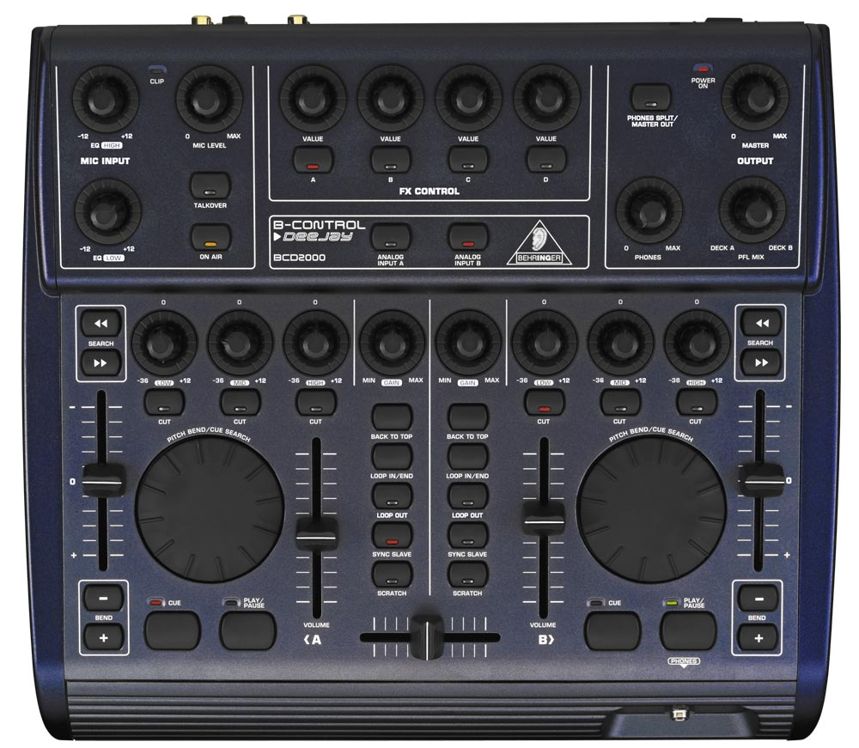
RISHI’s BCD MIDI CONTROL SETUP
VOL CH1
VOL CH2
VOL CH3
VOL CH4
Scene UP
Play CH1
Play CH2
Play CH3
Play CH4
Scene DN
Load Left
Load Right
ALT+
= RRWD
Pitch Adj DN
LEFT DECK
RIGHT DECK
Pitch Adj DN
ALT+
= RRWD
Feedback
Wetness
Feedback
Wetness
Feedback
Wetness
Feedback
Wetness
1
Delay
1
2
Delay
2
3
Delay
3
4
Delay
3
ALT+
= FFWD
Pitch Adj UP
ALT+
= FFWD
Pitch Adj UP
Loop
START
Cue PT2
Cue PT3
Cue PT4
Cue PT2
Cue PT3
Cue PT4
Loop
END
Loop
On/Off
Scroll Crates
& Tracks
CH2
Filter
Scroll Crates
& Tracks
CH1
Filter
Loop
# UP
CH4
Filter
Loop
# DN
CH3
Filter
+
+
PITCH
BEND
PITCH
BEND
-
-
Cue PT1
PLAY/STOP
Crossfader
Cue PT1
PLAY/STOP
SERATO
ABLETON

